Slide 1

VIX Volatility Predictor
Rajeev Panwar
This Photo by Unknown Author is licensed under CC BY
Notes:
Good morning - Im here to pitch the VIX index based retail trader tool today - And to start with I would like to comment on the current investment reality

Slide 2
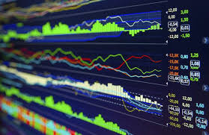
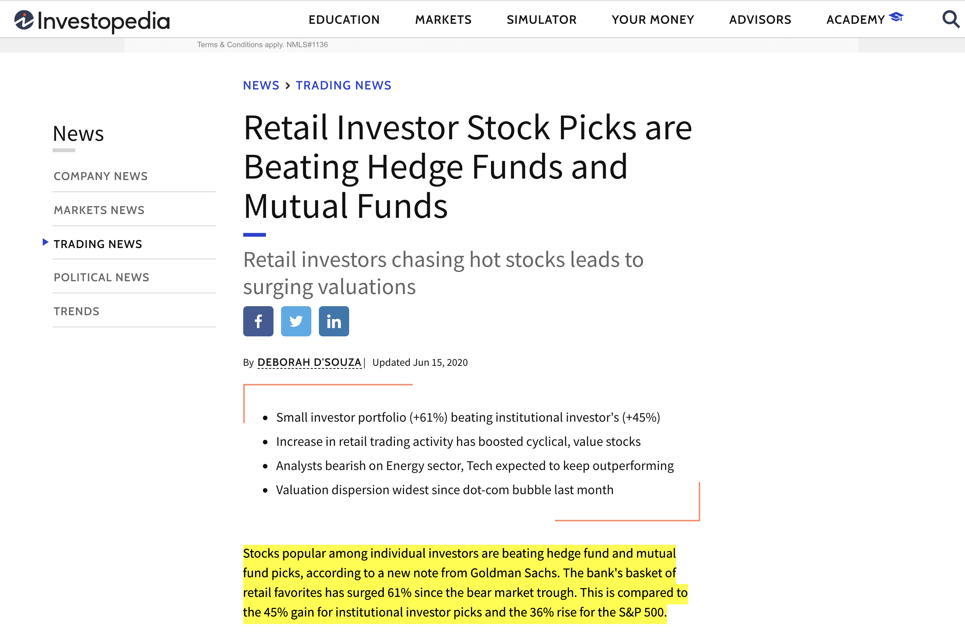
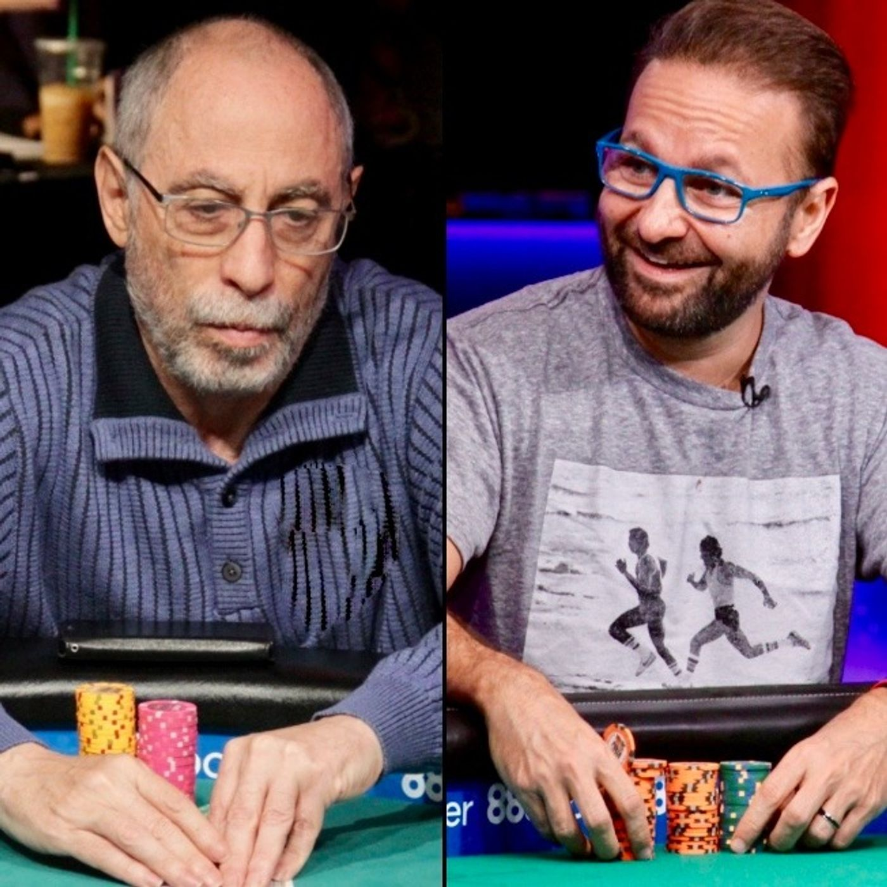
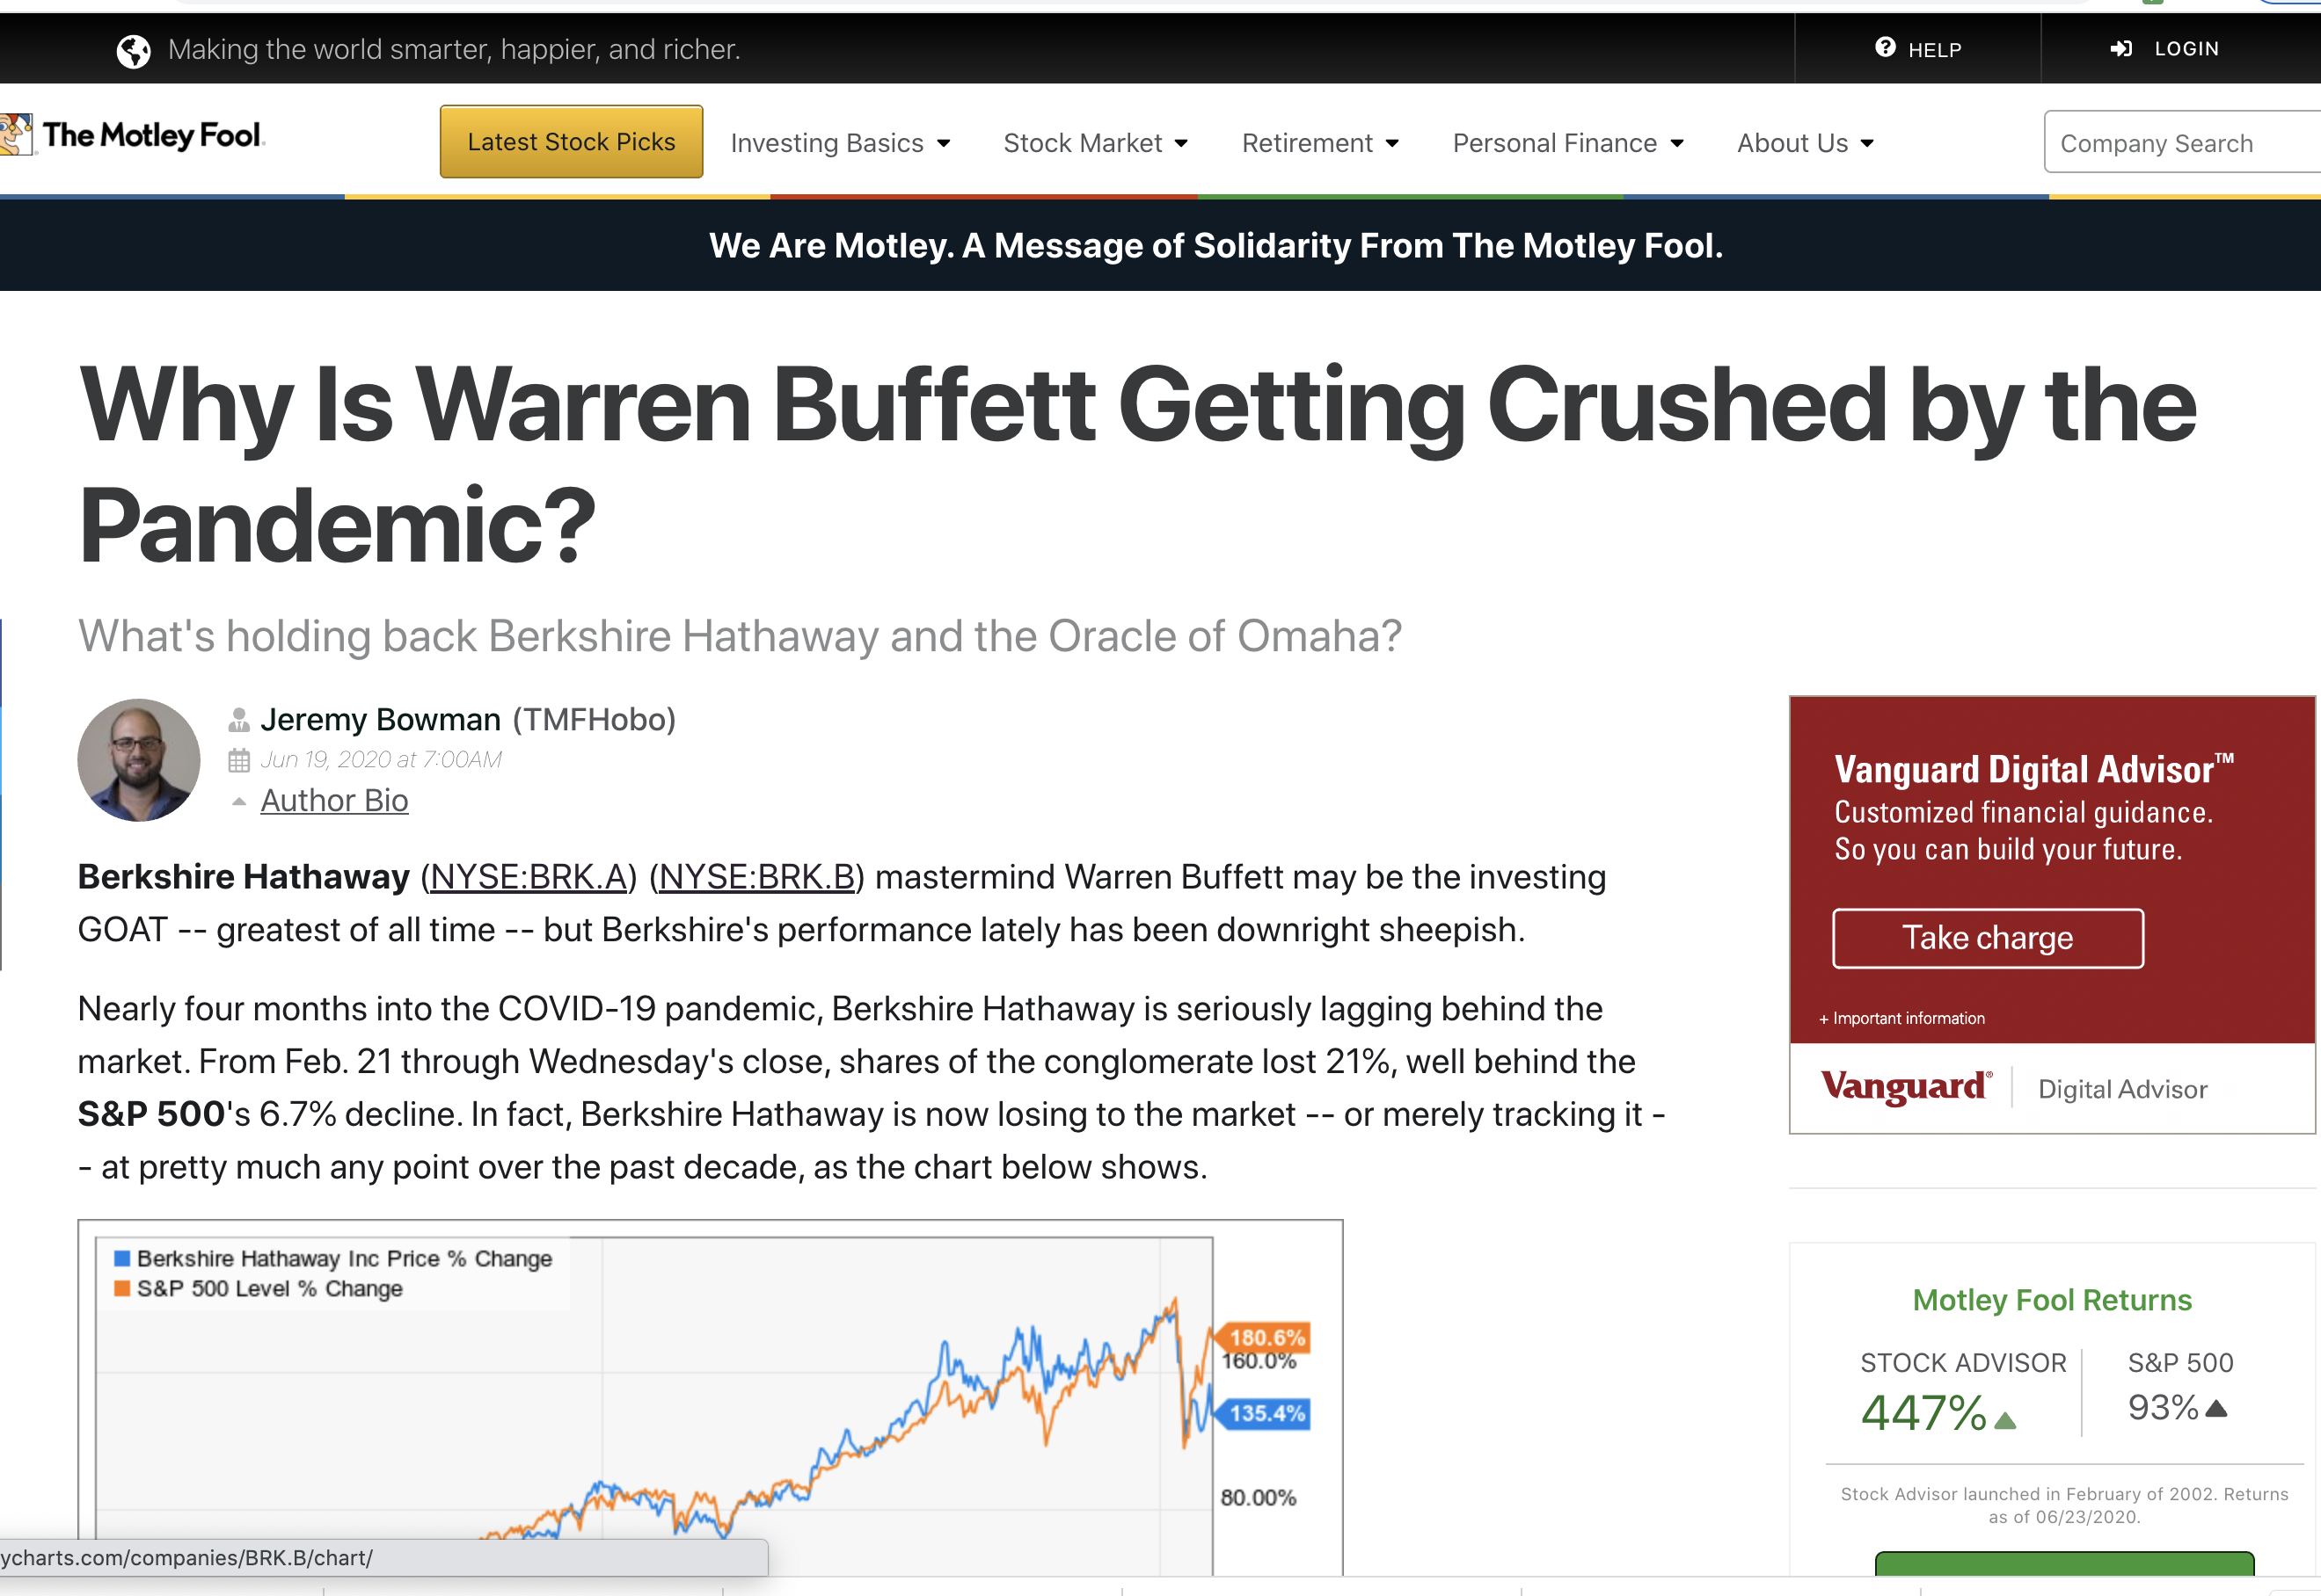

Slide 3

Beware - Danger Lurks!
Competing against Machine Learning Trading Algorithms -‘computational outmatched’
Market Volatility – ‘Friend’ or ‘Foe’?
“in unsettled waters, are wonderful beasts of the ocean to be found” - unknown
This Photo by Unknown Author is licensed under CC BY-SA
Notes:
Depends on which kind of trader you’re talking to

Slide 4
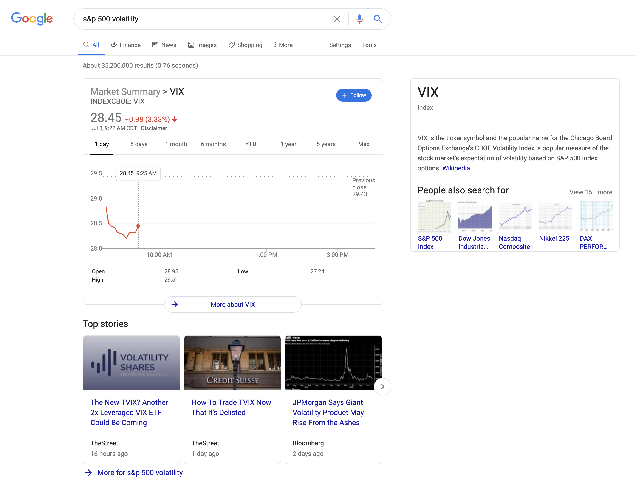
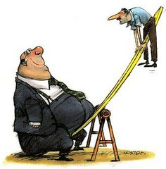

Volatility Index (VIX) aka ‘Fear Gauge’ or ’Fear Index’
Widely acknowledged as the best indicator of implied future volatility (for over 25 years)
Challenge – CBOE VIX is for most part inscrutable to the retail mom/pop investor
Key characteristics
This Photo by Unknown Author is licensed under CC BY-SA

Slide 5
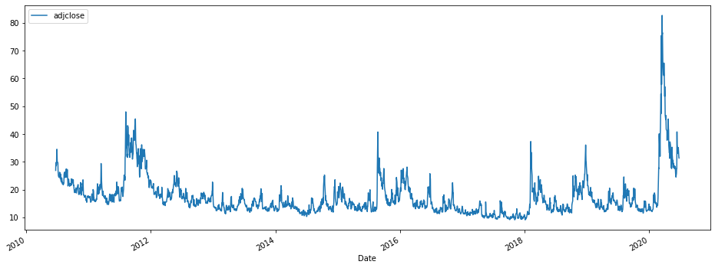
Volatility Index (VIX) aka ‘Fear Gauge’ or ’Fear Index’
Covid-19
Mid-term election –
2012
Election Year & Big Tax Cut
Index Value
Trade War & Iran Crises
Year

Slide 6
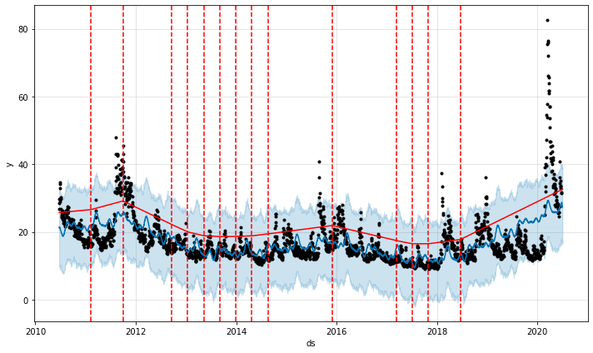
Verifying Key Changepoints Using Prophet
Covid-19
Mid-term election –
2012
Trade War & Iran Crises
Election Year & Big Tax Cut
Index Value
Year

Slide 7
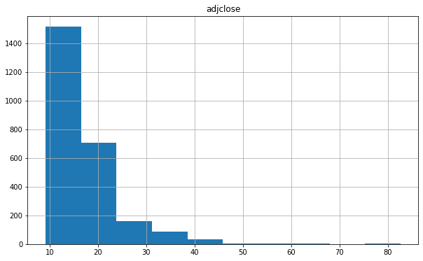
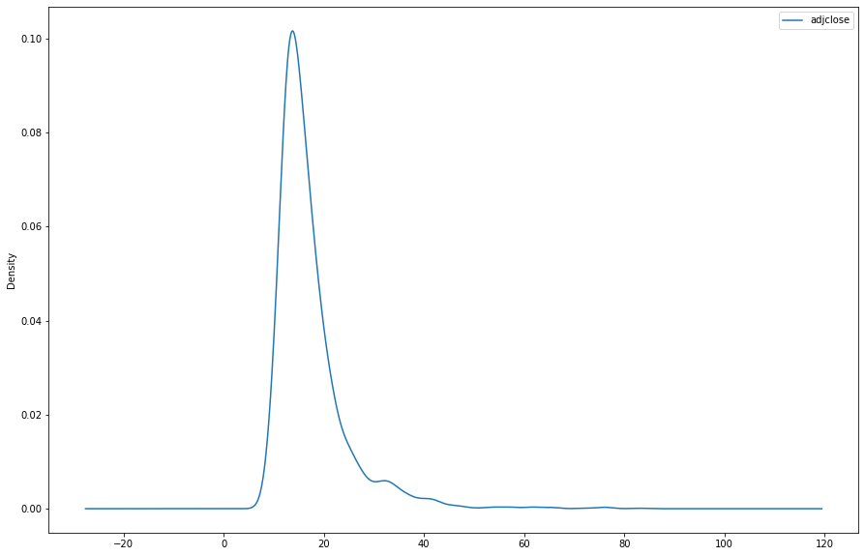
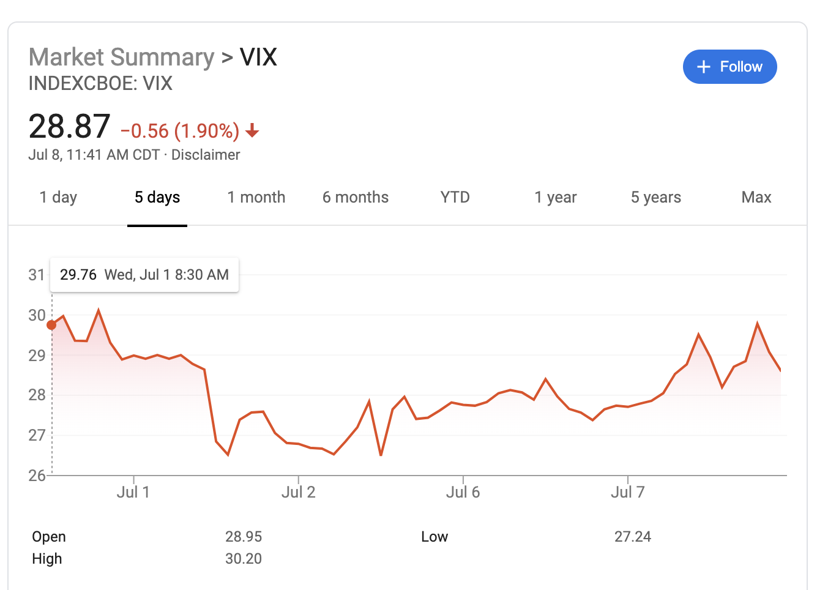

How Frequently Do Investors Panic!
~85%
60%
Number of Observations
Index Value
Thank-fully Institutional investors seem to be level-headed for most part of the decade!

Slide 8
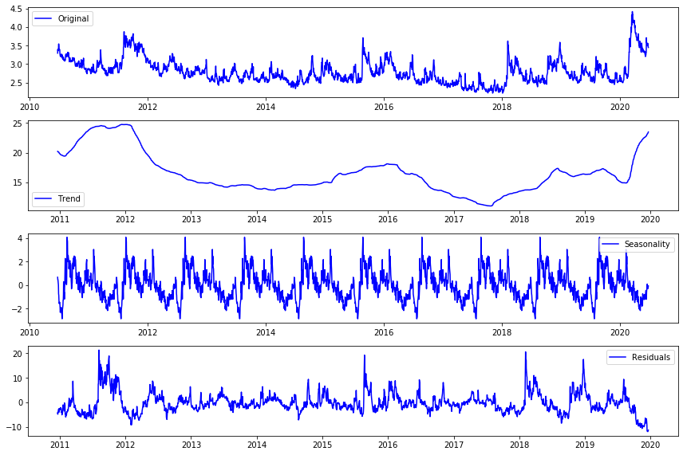

Famous Last Words!
44th
45th
Rest assured that election-induced volatility is coming!

Slide 9
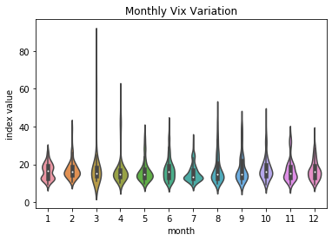
Last of the Famous Last Words!
End of Q1 & Q2 seem to experience more volatility than the latter half of year – ‘Critical’ Q2 is here! Buckle up!!!
Q1
Q2

Slide 10
Time Series Forecasting VIX
Baseline didn’t do too badly
Prophet saw the lowest RMSE for the 2nd & 8th day forecast
ARIMA with Exogenous Variable struggled – S&P500 Daily volumes of shares traded
Hyper Tuned ARIMA did well
LSTM clearly improved on the performance of ever other model
Model | RMSE | % Error (VIX - 17) | % Error (VIX – 27)
Baseline | 3.34 | ~19% | ~12%
Prophet | 6.58 | ~38% | ~24%
Arima (Exog. Variable) | 7.25 | ~42% | ~26%
Arima (5,0,1) | 2.94 | ~17% | ~11%
Neural Net - LSTM | 2.29 | ~13% | ~8%

Slide 11
The Process (Next Steps)
Develop trading strategy tool to alert retail investor on expected % movement over predicted time period ‘t’ (Final Product)
5
Stretch goal – identify key thresholds for development of alert system
4
MVP
Time series forecast VIX using a baseline model, ARIMA. PROPHET & LSTM – Evaluation Criteria - RMSE
3
Exploratory data analysis
2
Web-scraped historic daily adjusted closing price from Yahoo Finance – 10 years of VIX Index prices ~ 2517 observations
1

Slide 12

THANKS

Slide 13
APPENDIX

Slide 14
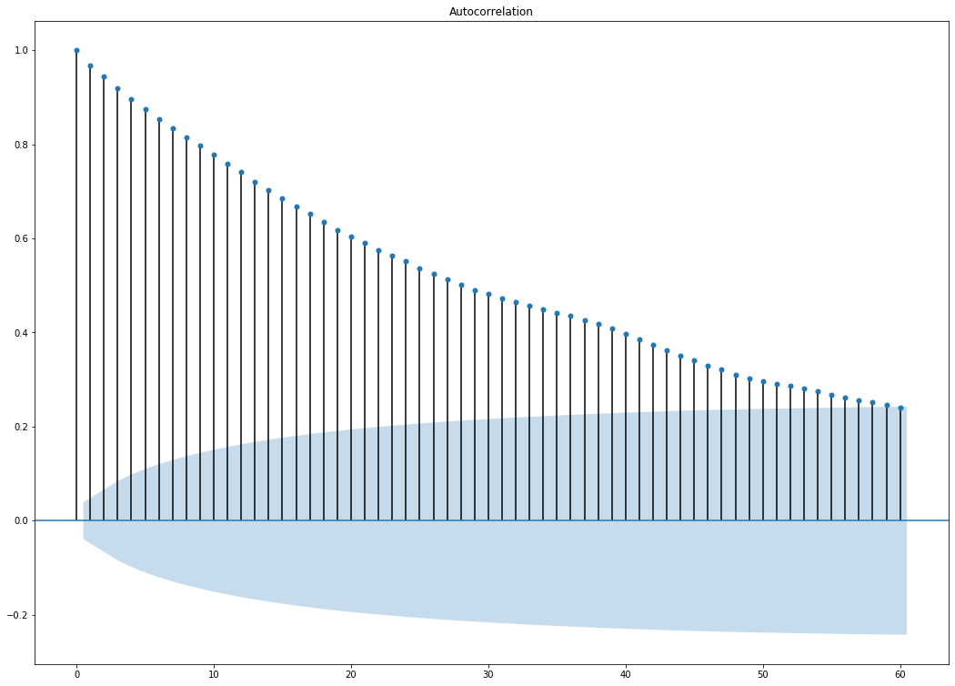
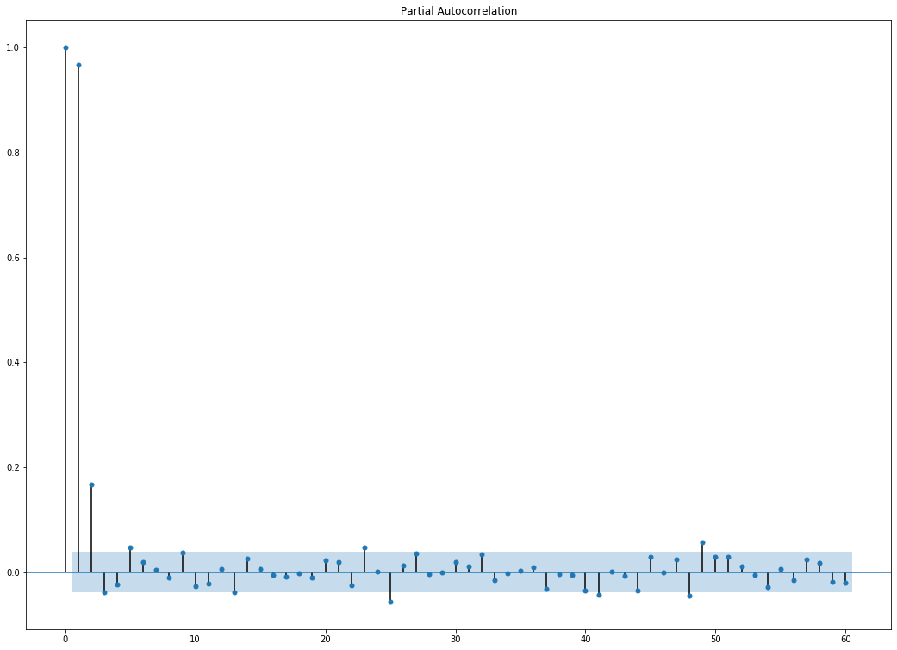
ACF & PACF

